Slide 1
Chapter 14: File System Implementation

Slide 2
Outline
File-System Structure
File-System Operations
Directory Implementation
Allocation Methods
Free-Space Management
Efficiency and Performance
Recovery
Example: WAFL File System

Slide 3
Objectives
Describe the details of implementing local file systems and directory structures
Discuss block allocation and free-block algorithms and trade-offs
Explore file system efficiency and performance issues
Look at recovery from file system failures
Describe the WAFL file system as a concrete example

Slide 4
Directory Implementation
Linear list of file names with pointer to the data blocks
  Simple to program
  Time-consuming to execute
    Linear search time
    Could keep ordered alphabetically via linked list or use B+ tree
Hash Table – linear list with hash data structure
  Decreases directory search time
  Collisions – situations where two file names hash to the same location
  Only good if entries are fixed size, or use chained-overflow method

Slide 5
Allocation Method
An allocation method refers to how disk blocks are allocated for files:
  Contiguous
  Linked
  File Allocation Table (FAT)

Slide 6
Contiguous Allocation Method 1
An allocation method refers to how disk blocks are allocated for files:
Each file occupies set of contiguous blocks
  Best performance in most cases
  Simple – only starting location (block #) and length (number of blocks) are required
  Problems include:
    Finding space on the disk for a file,
    Knowing file size,
    External fragmentation, need for compaction off-line (downtime) or on-line

Slide 7
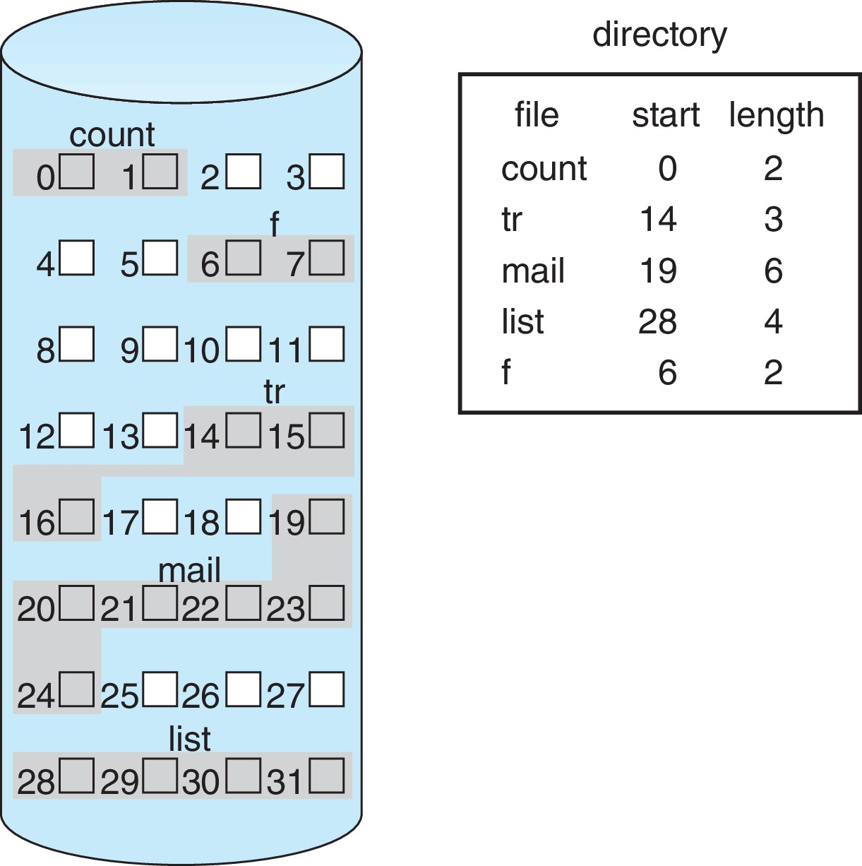
Contiguous Allocation (Cont.)
Mapping from logical to physical (block size =512 bytes)
Block to be accessed = starting address + Q
Displacement into block = R
Q
LA/512
R

Slide 8
Linked Allocation
Each file is a linked list of blocks
File ends at nil pointer
No external fragmentation
Each block contains pointer to next block
No compaction, external fragmentation
Free space management system called when new block needed
Improve efficiency by clustering blocks into groups but increases internal fragmentation
Reliability can be a problem
Locating a block can take many I/Os and disk seeks

Slide 9
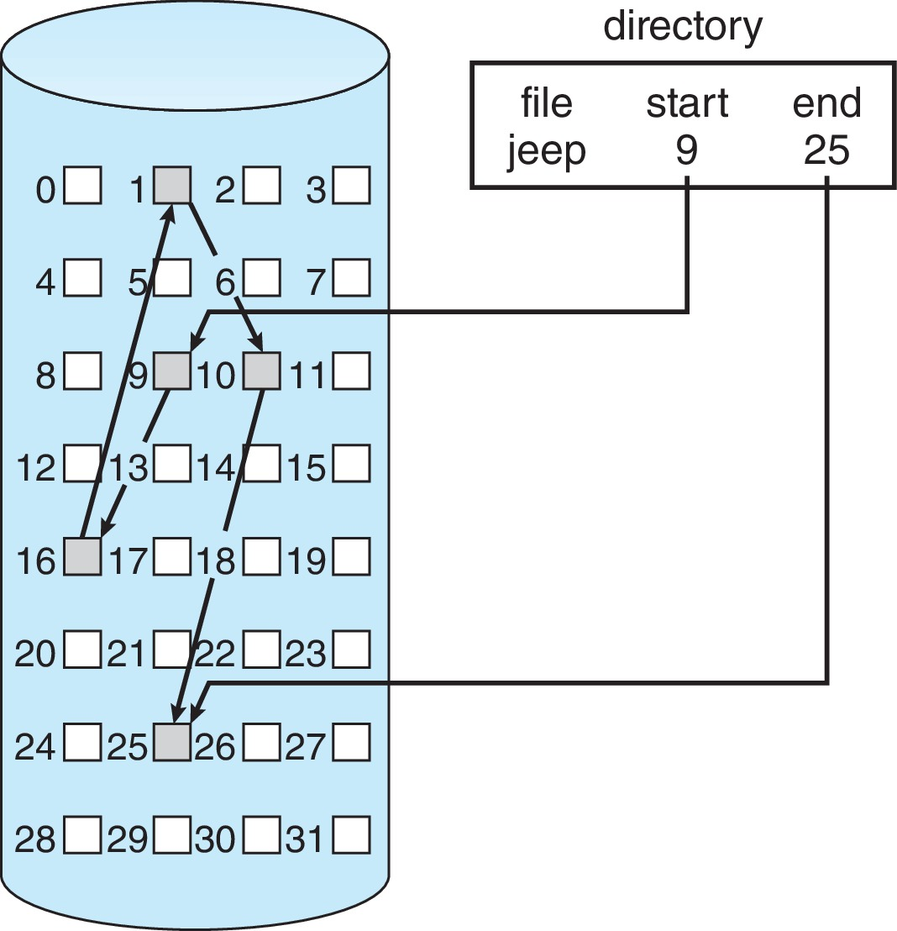
Linked Allocation Example 1
Each file is a linked list of disk blocks: blocks may be scattered anywhere on the disk
Scheme

Slide 10
Linked Allocation (Cont.)
Mapping
Block to be accessed is the Q^{th} block in the linked chain of blocks representing the file.
Displacement into block = R + 1
Q
LA/511
R

Slide 11
FAT Allocation Method
Beginning of volume has table, indexed by block number
Much like a linked list, but faster on disk and cacheable
New block allocation simple

Slide 12
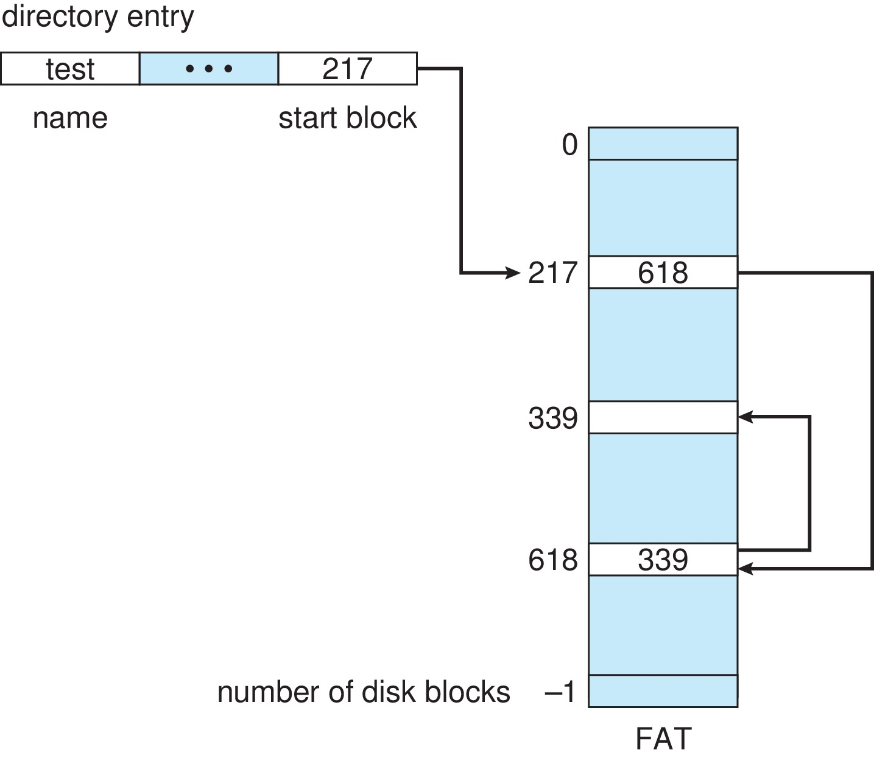
File-Allocation Table

Slide 13
End of Chapter 14

Slide 14
Linked Allocation

Slide 15
Linked Allocation
Each file is a linked list of disk blocks: blocks may be scattered anywhere on the disk
block =
pointer
Mapping
Q
LA/511
R
  Block to be accessed is the Qth block in the linked chain of blocks representing the file.
  Displacement into block = R + 1

Slide 16
Indexed Allocation (Cont.)
Need index table
Random access
Dynamic access without external fragmentation, but have overhead of index block
Mapping from logical to physical in a file of maximum size of 256K bytes and block size of 512 bytes. We need only 1 block for index table
Q
LA/512
R
Q = displacement into index table
R = displacement into block

Slide 17
Indexed Allocation – Small Files
Mapping from logical to physical in a file of unbounded length (block size of 512 words)
Linked scheme – Link blocks of index table (no limit on size)
Q₁
LA / (512 x 511)
R₁
  Q₁ = block of index table
  R₁ is used as follows:
Q₂
R₁ / 512
R₂
  Q₂ = displacement into block of index table
  R₂ displacement into block of file:

Slide 18
End of Chapter 14

Slide 19
In-Memory File System Structures
Mount table storing file system mounts, mount points, file system types
System-wide open-file table contains a copy of the FCB of each file and other info
Per-process open-file table contains pointers to appropriate entries in system-wide open-file table as well as other info
The following figure illustrates the necessary file system structures provided by the operating systems
Figure 12-3(a) refers to opening a file
Figure 12-3(b) refers to reading a file
Plus buffers hold data blocks from secondary storage
Open returns a file handle for subsequent use
Data from read eventually copied to specified user process memory address

Slide 20
Indexed Allocation – Linked Scheme
Link blocks of index table (no limit on size)
Outer-level mapping scheme
  Q₁ = block of index table
  R₁ is used as follows
R₁ is used as follows
Inner-level mapping scheme
  Q₂ = displacement into block of index table
  R₂ displacement into block of file
Q₁
LA / (512 x 511)
R₁
Q₂
R₁ / 512
R₂

Slide 21
Indexed Allocation – Linked Scheme
Link blocks of index table (no limit on size)
Outer-level Mapping scheme
  Q₁ = block of index table
  R₁ is used as follows
Inner-level Mapping scheme
  Q₂ = displacement into block of index table
  R₂ displacement into block of file
Q₁
LA / (512 x 511)
R₁
Q₂
R₁ / 512
R₂

Slide 22
Indexed Allocation – Two-level Scheme
Two-level index (4K blocks could store 1,024 four-byte pointers in outer index -> 1,048,567 data blocks and file size of up to 4GB)
Mapping scheme:
Q₁
LA / (512 x 512)
R₁
  Q₁ = displacement into outer-index
  R₁ is used as follows:
Q₂
R₁ / 512
R₂
  Q₂ = displacement into block of index table
  R₂ displacement into block of file:

